Slide 1
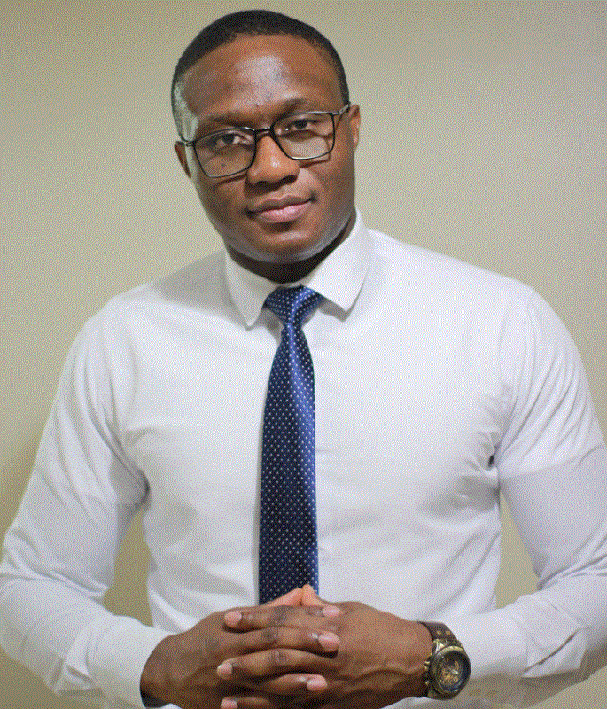
Albert Eromosele
TECHNICAL SUPPORT ENGINEER

Slide 2
Powershell For Administrators
Albert Eromosele
TECHNICAL SUPPORT ENGINEER

Slide 3


MAINTENANCE
TROUBLESHOOT

Slide 4





Slide 5
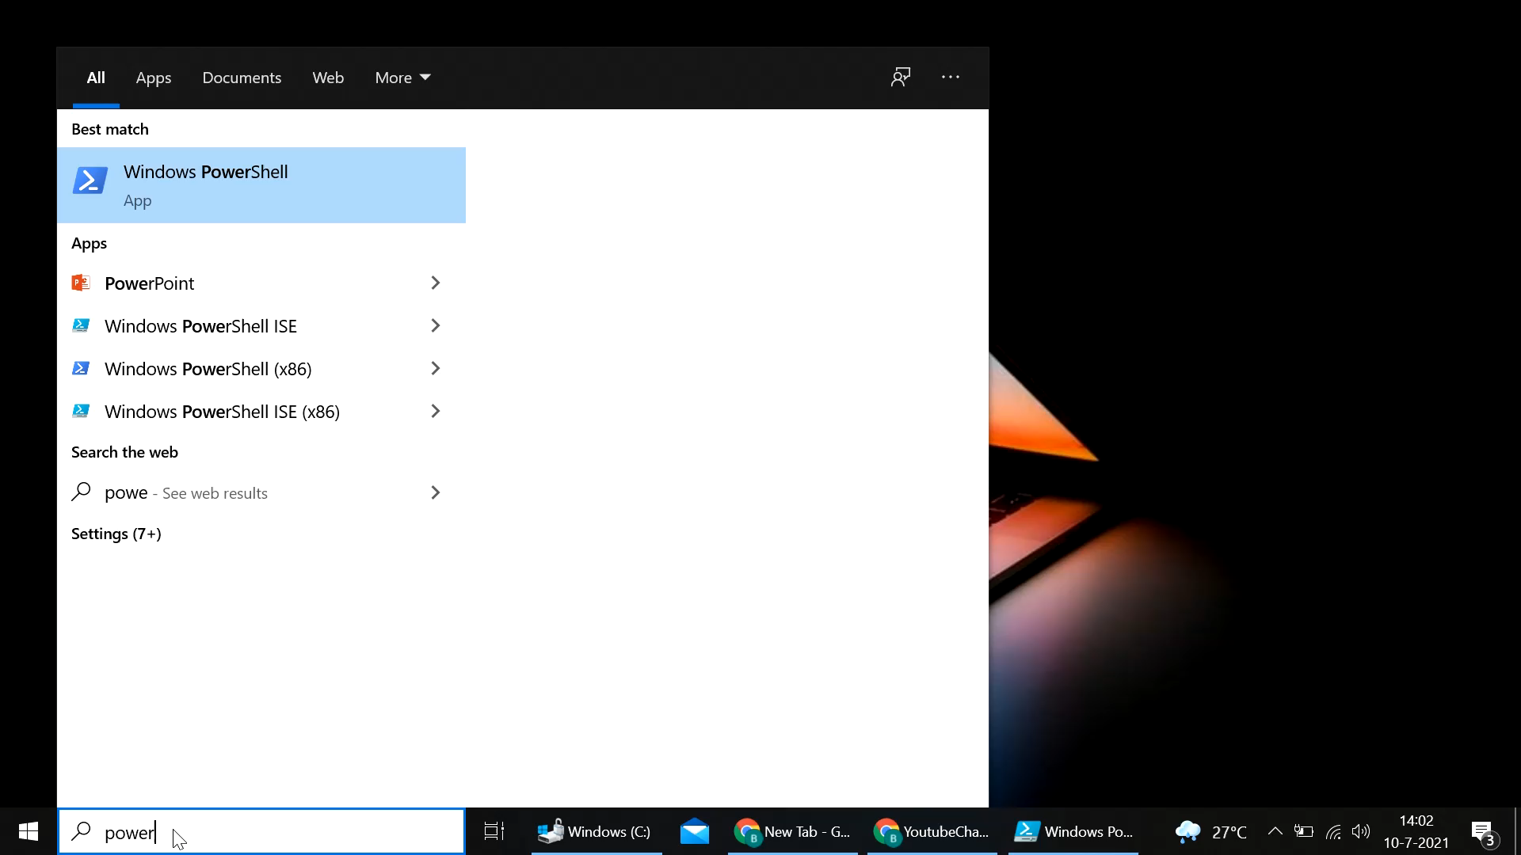
POWERSHELL

Slide 6
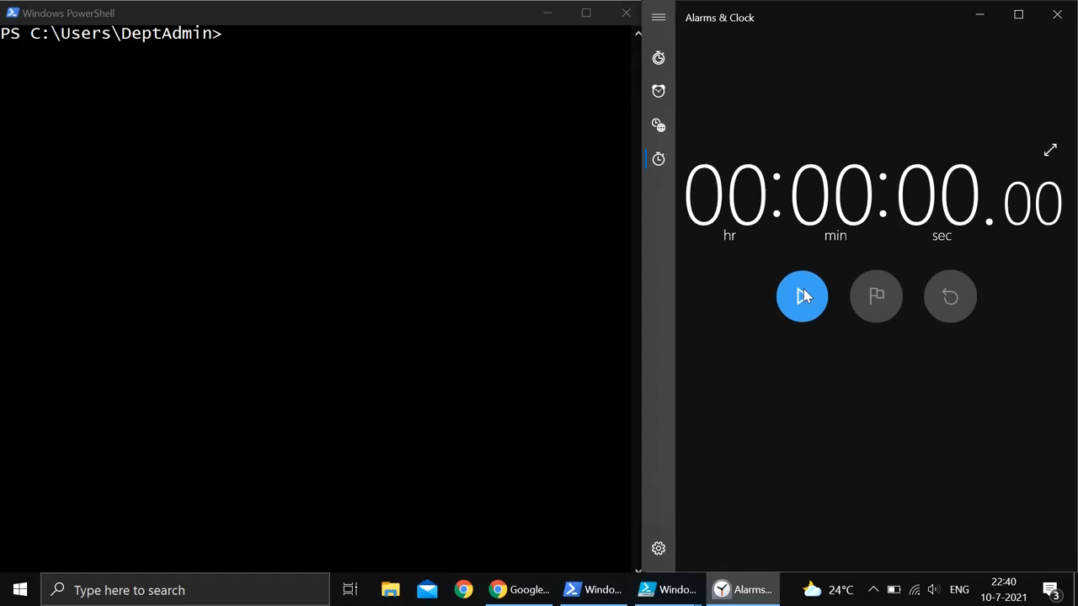
POWERSHELL

Slide 7
MAINTENANCE
TROUBLESHOOT

Slide 8
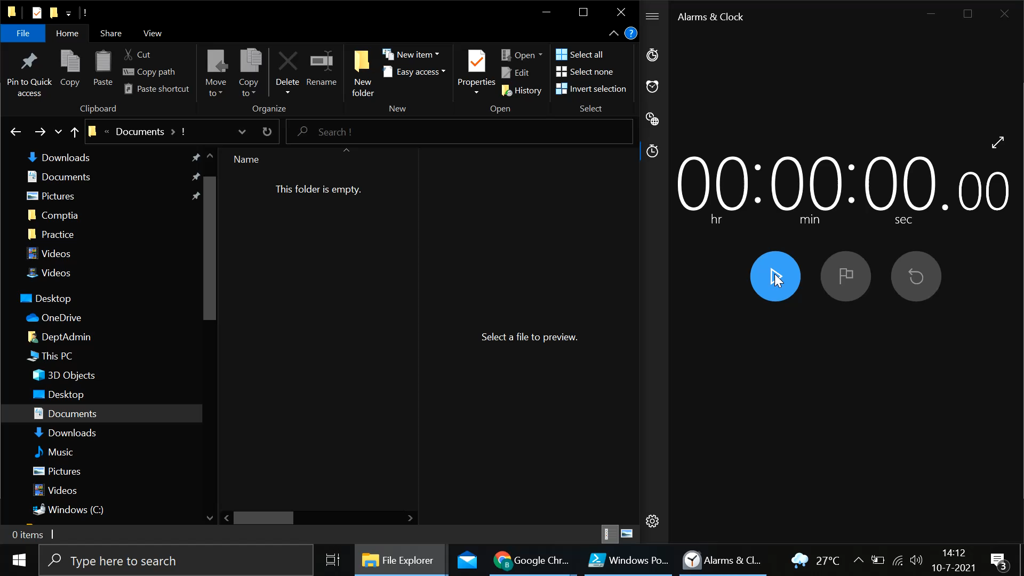

Slide 9
Albert Eromosele
IT SUPPORT TECH

Slide 10
